Slide 1


LENZIE ACADEMY PTA
AGM & MEETING
THURSDAY 10TH SEPTEMBER, 2025

Slide 2

LENZIE ACADEMY PTA
Welcome & Introductions
Who are the PTA?
What the PTA do
Quiz Nights
Sponsored Santa Dash
Sponsored Halloween Fun Run
Race Nights
MasterChef Night
Comedy Night
Online Raffles
Doughnut sales & Dress Down Days

Slide 3

LENZIE ACADEMY PTA
How much is raised? - £13,471
What the PTA fund - £16,883
Donation towards New LEZ School Bus
Mobile Phone Pockets for mobile phone storage
Science, Maths, Art, Design & Photography Equipment
Tropical Rainforest Mini-Zoo Experience
Wellbeing Day Hire Slide, Assault course & Mega Bouncy Castle
Donations to School Clubs, Trips, Events & School Show
Science Fair & Bounce Back Day
Subscriptions to Online Maths Programs
Silent Disco
P7 Transition Comic Book

Slide 4






LENZIE ACADEMY PTA
Contact Details/Communication
PTA Email – lenzieacademypta@gmail.com
Group Calls – Email via School
PTA Website – www.lenzieacademypta.org.uk
PTA Facebook - Lenzie Academy PTA
School Instagram - @wearelenzieacademy
School Newsletters

Slide 5
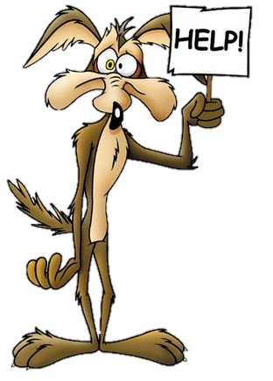
LENZIE ACADEMY PTA
How parents can help
  Monetary Donation via electronic bank transfer or PayPal
  Join Brand New PTA Lenzie Lotto
  Use Easy Fundraising when shopping online
  Buy Tickets to PTA Fundraising Events
  Raffle Donations
  Buy Raffle Tickets
  Buy Doughnuts
  Sponsor Pupils at Sponsored Events
  Join the PTA

Slide 6

LENZIE ACADEMY PTA
Office Bearer Nominations
  Chair
  Vice Chair
  Treasurer
  Secretary
  Website, Social Media & Communication
  Raffle Prize Committee
  Grants

Slide 7

LENZIE ACADEMY PTA
Treasurer’s Report (Annual Accounts)
    New Treasurer & Handover
    Current Balance - £10,234
    The 500 Club - £3,505
    Easyfundraising - £354
    World Cup Doughnuts - £397
    Last Day of School Dress Down Day - £167
    Bank Account Audit
  Total Raised Last School Year - £13,471
  Total Expenditure Last School Year - £16,883
  Target for 2026-27 - £10,000?

Slide 8
LENZIE ACADEMY PTA
PTA MEETING – Thurs 10th Sept
Agenda
Welcome & Introductions
Previous Minutes Approval
Treasurer’s Report & Bank Account Audit
School Update
New Bids
5. Review Previous Events
  World Cup Doughnut Sale
  Dress Down Day June
Upcoming Event Planning
  Quiz Night
  Online Raffles – Parents & Businesses
  Pupil Sponsored Event
  Spring Parent Event – Comedy Night/Bongo Bingo/Themed Night/Another

Slide 9
LENZIE ACADEMY PTA
PTA MEETING – Thurs 10th Sept
Agenda Continued
  Dress Down Days
  Doughnut Sales
  Lenzie Lotto
  Another
7. Grant Update – Caroline/Susan
Parents Nights & School Events e.g. Parent Engagement Evenings
AOB
  Showcase PTA Purchases
  Parent Council Meetings
Next Meeting - October
  Meeting Room Booking

Slide 10

LENZIE ACADEMY PTA

